Slide 1

Fearfully and Wonderfully Created and Recreated with value
Genesis 2:7-17

Slide 2
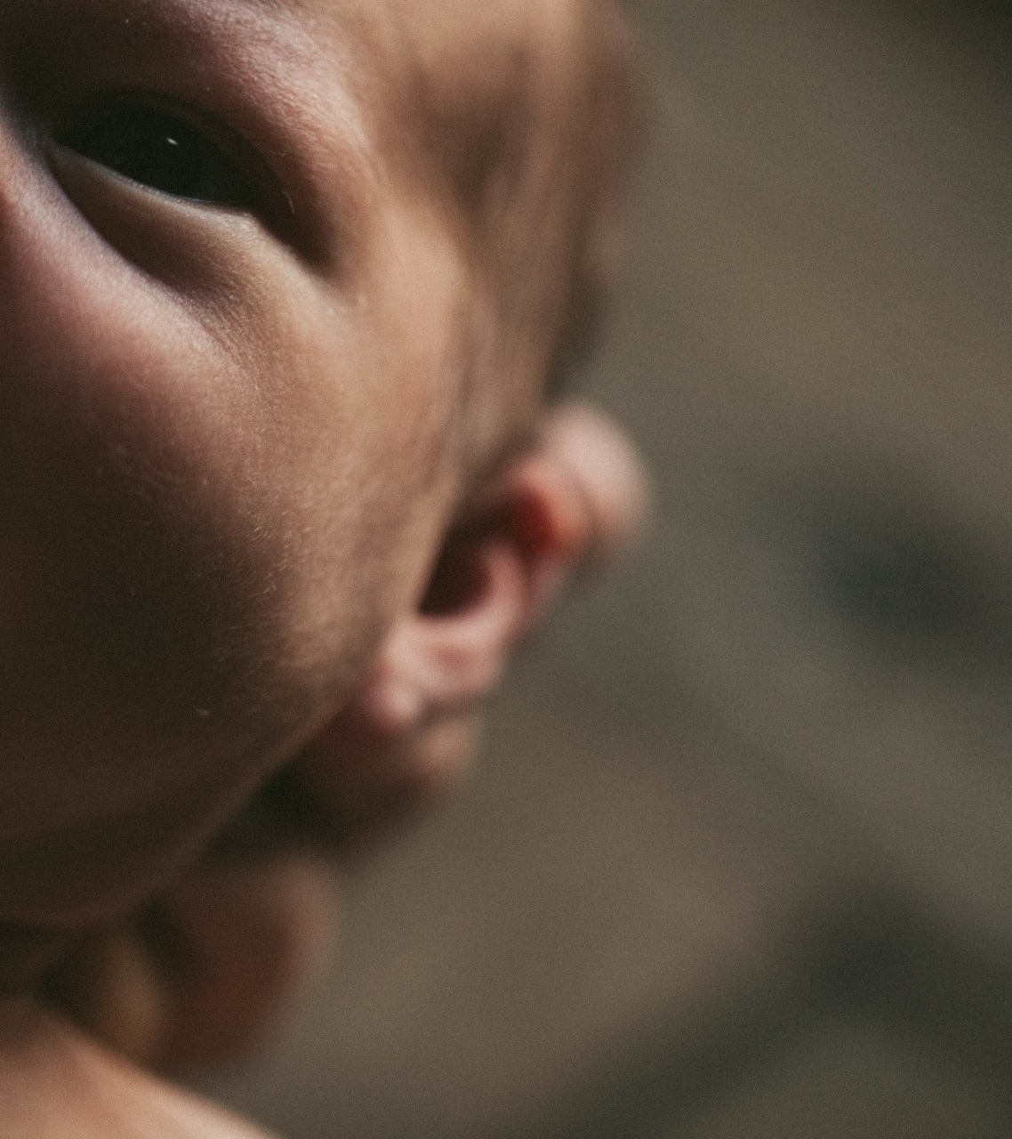
Handmade items are precious and valuable.
Handmade Adam and Eve were valuable.
Sin has not destroyed our value to God.
All humans are handmade by God and are valuable.
Notes:
Carefully handmade items are inherently of more value than items that are mass-produced. It is far more common for a hand-stitched quilt to become a priceless family heirloom than one that was bought at the store. The one will be carefully preserved and passed on from one generation to the next, the other will likely get tossed in the trash after a few years of regular use.
The question is, why do handmade items have this inherent value? It is because every handmade item is, in a way, a picture of its maker. The desire to create proceeds from the heart of the maker. The design and plan reveal the wisdom of the maker. And the finished product is the incarnation of both heart and mind, produced through hours of labor by a skillful hand that was developed over years of practice. Carefully and lovingly hand-crafted items become invaluable keepsakes because they are more than just items; they are a lasting connection to the one who made them.
If that is true of a quilt or a piece of artwork, how much more is it true of us? God’s Word from Genesis 2 reminds us that God made mankind differently than He made the rest of creation. Everything else God made He made by speaking it into existence. But not Adam. With Adam, God literally got His hands dirty. He carefully and intentionally fashioned Adam’s body from the dust of the ground. Then, after the physical form was made, God breathed His own life-giving breath into the dust and made it a living creature. The same thoughtful care is later given to the creation of woman, as God took one of Adam’s ribs and fashioned a body around that rib and gave her life. [click]
All of creation is God’s handiwork, but Adam and Eve were His masterpieces. They were designed and made in His image. They were filled with God’s own life. They were what God had in mind when He uttered the first “let there be.” God gave Adam dominion over His creation and placed him in the garden to work it and keep it because it was all made for him and his family. They were reflections of God’s loving character and divine skill. And by the act of this careful and intentional creation of His works of art, God bestowed upon human beings inestimable value.
True, we cannot deny that sin has deeply corrupted God’s masterpieces. We also heard this morning that God had put the tree of the knowledge of good and evil in the midst of the garden and commanded Adam not to eat of it, lest he die. And sadly, we know that he did eat of it, and as a result, sin and death entered our world and cursed God’s masterpieces.
Ever since that moment, Adam and Eve and all their children have been broken by sin. We have bodies that can be malformed, become filled with diseases, and grow old and weak and die. We also have minds and souls that have been warped by sin. Instead of thinking the way God thinks and loving the way that God loves, our minds are filled with evil and selfish thoughts and desires.
But this does not in any way devalue God’s handiwork! God Himself tells us that even now, after sin has entered His perfect world, He still fearfully and wonderfully creates each one of us. King David was a sinner like the rest of mankind, yet the Holy Spirit inspired David to write the words of Psalm 139: “For you formed my inward parts; you knitted me together in my mother's womb. I praise you, for I am fearfully and wonderfully made. Wonderful are your works; my soul knows it very well” (Psalm 139:13-14).
It wasn’t just Adam and Eve who were hand-crafted by God. [click] Every single human being, from the least to the greatest, is still carefully handmade by God. He plans and designs our form and then skillfully knits us together in our mother’s wombs. Does the curse of sin and death affect us? Of course. But we are all still God’s handiwork. We are still created after the image of our Maker, even if that image is terribly marred by sin. And thus, from the moment of conception, when God begins His knitting together, until the day that God has determined for death, each person, in every stage and condition of life, has immeasurable value to the Lord. [click]

Slide 3
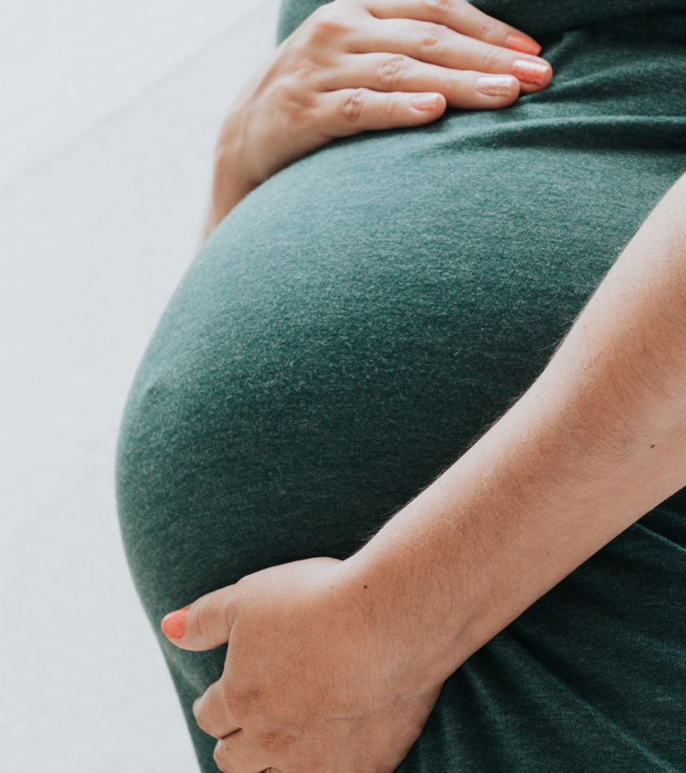
we don’t always recognize this great value in every human life.
We can miss the value in the unborn or infirm.
We can miss the value in the sick and dying.
We can miss the value in other sinners.
Notes:
Sadly, because sin has twisted our souls as deeply as our bodies, we don’t always see that great value in all the people God has created. We live in a world that values production. [click] We find value in things that can give us something in return. This is the line of thought that is often used to devalue unborn children or those with severe disabilities. The argument states that since the size or the condition of their bodies leaves them less able to perform what some consider to be normal functions, they must not have the same value as the rest of mankind.
We can easily fall into a similar error when thinking about the elderly, the dying, and those with untreatable illnesses. Instead of seeing the value inherent in them as one lovingly made by God and cared for by Him, we place an economic value on them. [click] The sick and dying often require a level of care that necessitates the sacrifice of both time and money. When dealing with people in such a condition, the devil, the world, and our own sinful nature tempt us to think more about the money that we could save and less about what God’s will is for them. Thus, every day we hear more and more frequently the argument that such people should be allowed to (or even encouraged to) die as quickly as possible at the hands of a doctor.
There are also times when it is the manifestation of sin itself which prevents us from seeing the value in another (or even in ourselves). When a person has made bad decisions and transgressed God’s Law, we are often tempted to think that God loves them less because of it. [click] And then we end up loving them less as a result. Make no mistake, the woman who gets pregnant out of wedlock, the young girl who in desperation ended her child’s life, and the homeless addict are all still precious to the Lord who knitted each one of them together in their mother’s womb. [click]

Slide 4
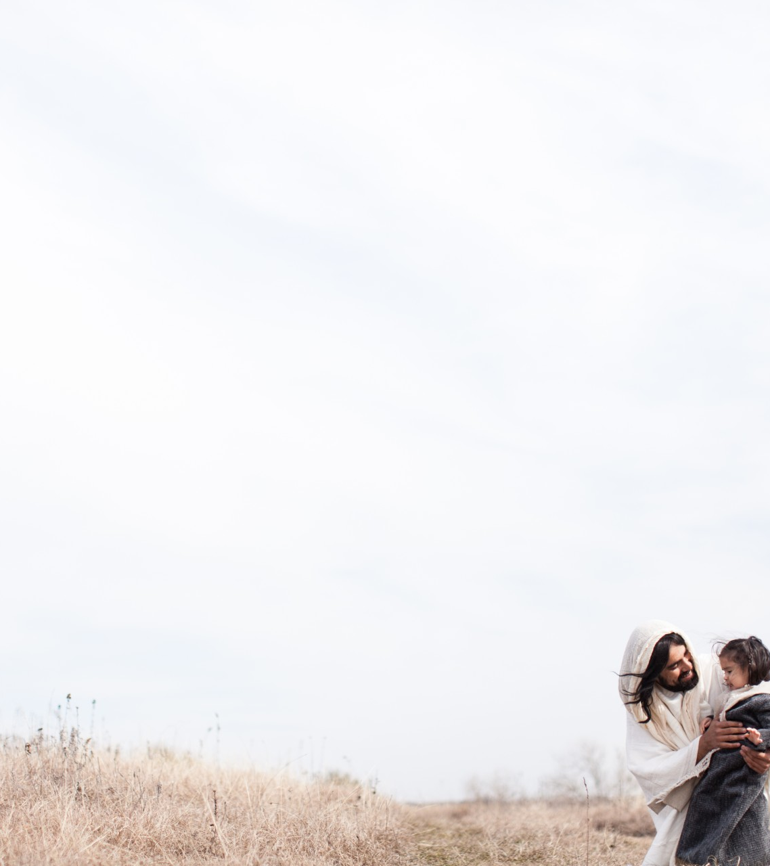
This great Value is revealed in Christ.
Jesus paid the ultimate price to ransom every person.
Jesus lived and redeemed every stage of human life and development.
Notes:
And, should we try to deny the value of any human being for any reason, we need only to think of the price that God was willing to pay to redeem and save His beloved creation which has been broken by sin. [click] Recall how St. Paul said, “You are not your own, for you were bought with a price” (1 Corinthians 6:19-20). Just what was that price? St. Peter said that you were ransomed from your sins, “not with perishable things such as silver or gold, but with the precious blood of Christ” (1 Peter 1:18-19). The Second Person of the Trinity, the only-begotten Son of God, became man. He was conceived by the Holy Spirit and allowed Himself to be knitted together in Mary’s womb. The Son of God was born and grew and lived like every man and woman broken by sin so that He might shed His blood and lay down His life for every man and woman broken by sin.
God was willing to pay the ultimate price for us. He humbled Himself and underwent every stage of human life and development from the womb to the grave to sanctify and ransom His precious creation in any and every condition or stage of development. [click] He was conceived and grew in Mary’s womb to sanctify and save all those in the womb. He lived in the flesh and “took our illnesses and bore our diseases” (Matthew 8:17) to redeem the sick and broken. He bore the shame of the cross to grant peace to those weighed down by the shame of their own poor choices. He laid down His own life to give everlasting life to all the dying.

Slide 5
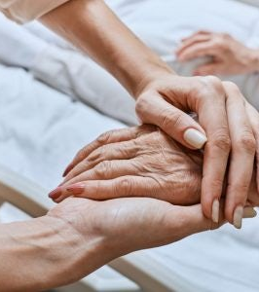
We have been recreated by Jesus to be and to see value.
You have been recreated because you are valuable to Christ!
You have been recreated to dwell in Christ eternally.
You have been recreated to recognize value in every person.
Notes:
By His own self-giving, God has atoned for the sins of the whole world, and He has gloriously reaffirmed the value of every single human life that He has created. You, who were fearfully and wonderfully made by God, have been yet more wonderfully re-created by Christ. [click] You have been washed in the blood of His Son through the waters of Holy Baptism and have been given new life in Him, a life that will never end. For “He saved us, not because of works done by us in righteousness, but according to his own mercy, by the washing of regeneration and renewal of the Holy Spirit… so that being justified by his grace we might become heirs according to the hope of eternal life” (Titus 3:5, 7).
Your failure to love God above all things and your reluctance to see the value in every person is forgiven. That forgiveness was won at the cross, delivered in your Baptism, promised to you by God’s Word, and confirmed for you by the crucified and risen body and blood of Jesus which you receive at the altar. And though your body will weaken and give way to physical decay and death, it will be raised again to live with God without corruption for all eternity. [click]
And what Jesus has done for you, He offers to all. As Christ has given us this new life in Him, He calls and empowers us to live like Him. Even though sin still dwells in our flesh, God is working in His children to refashion His image in us. [click] Your heart and mind are being renewed day by day to love like Jesus loves and to think like Jesus thinks. Your eyes are being opened to see to all others – the unborn, the weak and aged, the sick and dying, the guilty and shamed -- the way that Jesus sees them. He sees them as He sees you, as His masterpiece, wonderfully and fearfully created and recreated by Him to live with Him and the Father and the Holy Spirit now and forever. Amen.

