Slide 1
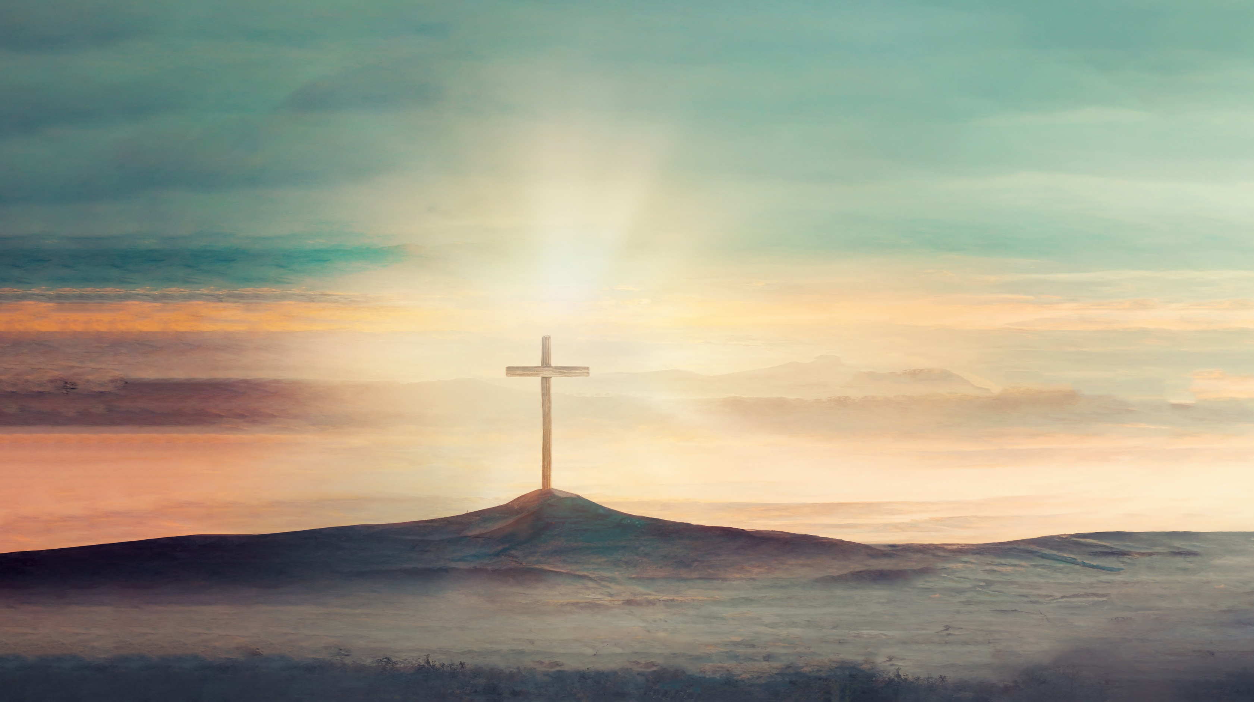


Life Sunday 2025
John 1:1-14

Slide 2
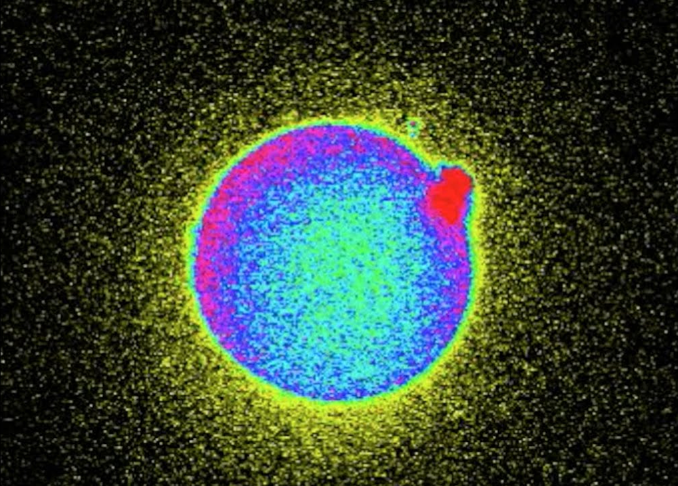
John 1:1-14
Life only begins in darkness…
Notes:
In the beginning, it was dark.
Life begins in darkness.
Shadows fell over the deeps.
Blackness enveloped the void.
But life only begins in darkness.
At Northwestern University in 2016, researchers captured on camera
irrefutable proof that life shines in the darkness.
They filmed fireworks marking the moment of fertilization.
The instant that sperm enzyme meets egg membrane,
zinc ions ignite and twinkle as a new embryo comes into being.
Like the sun’s corona when the moon eclipses it,
a flickering halo radiates a galaxy of kindled flecks
that flashbulb the otherwise obscured sphere –
microscopic, of course, but nevertheless undeniable.
And every human life features this flash of the Maker’s magic no matter the circumstances. [click]

Slide 3
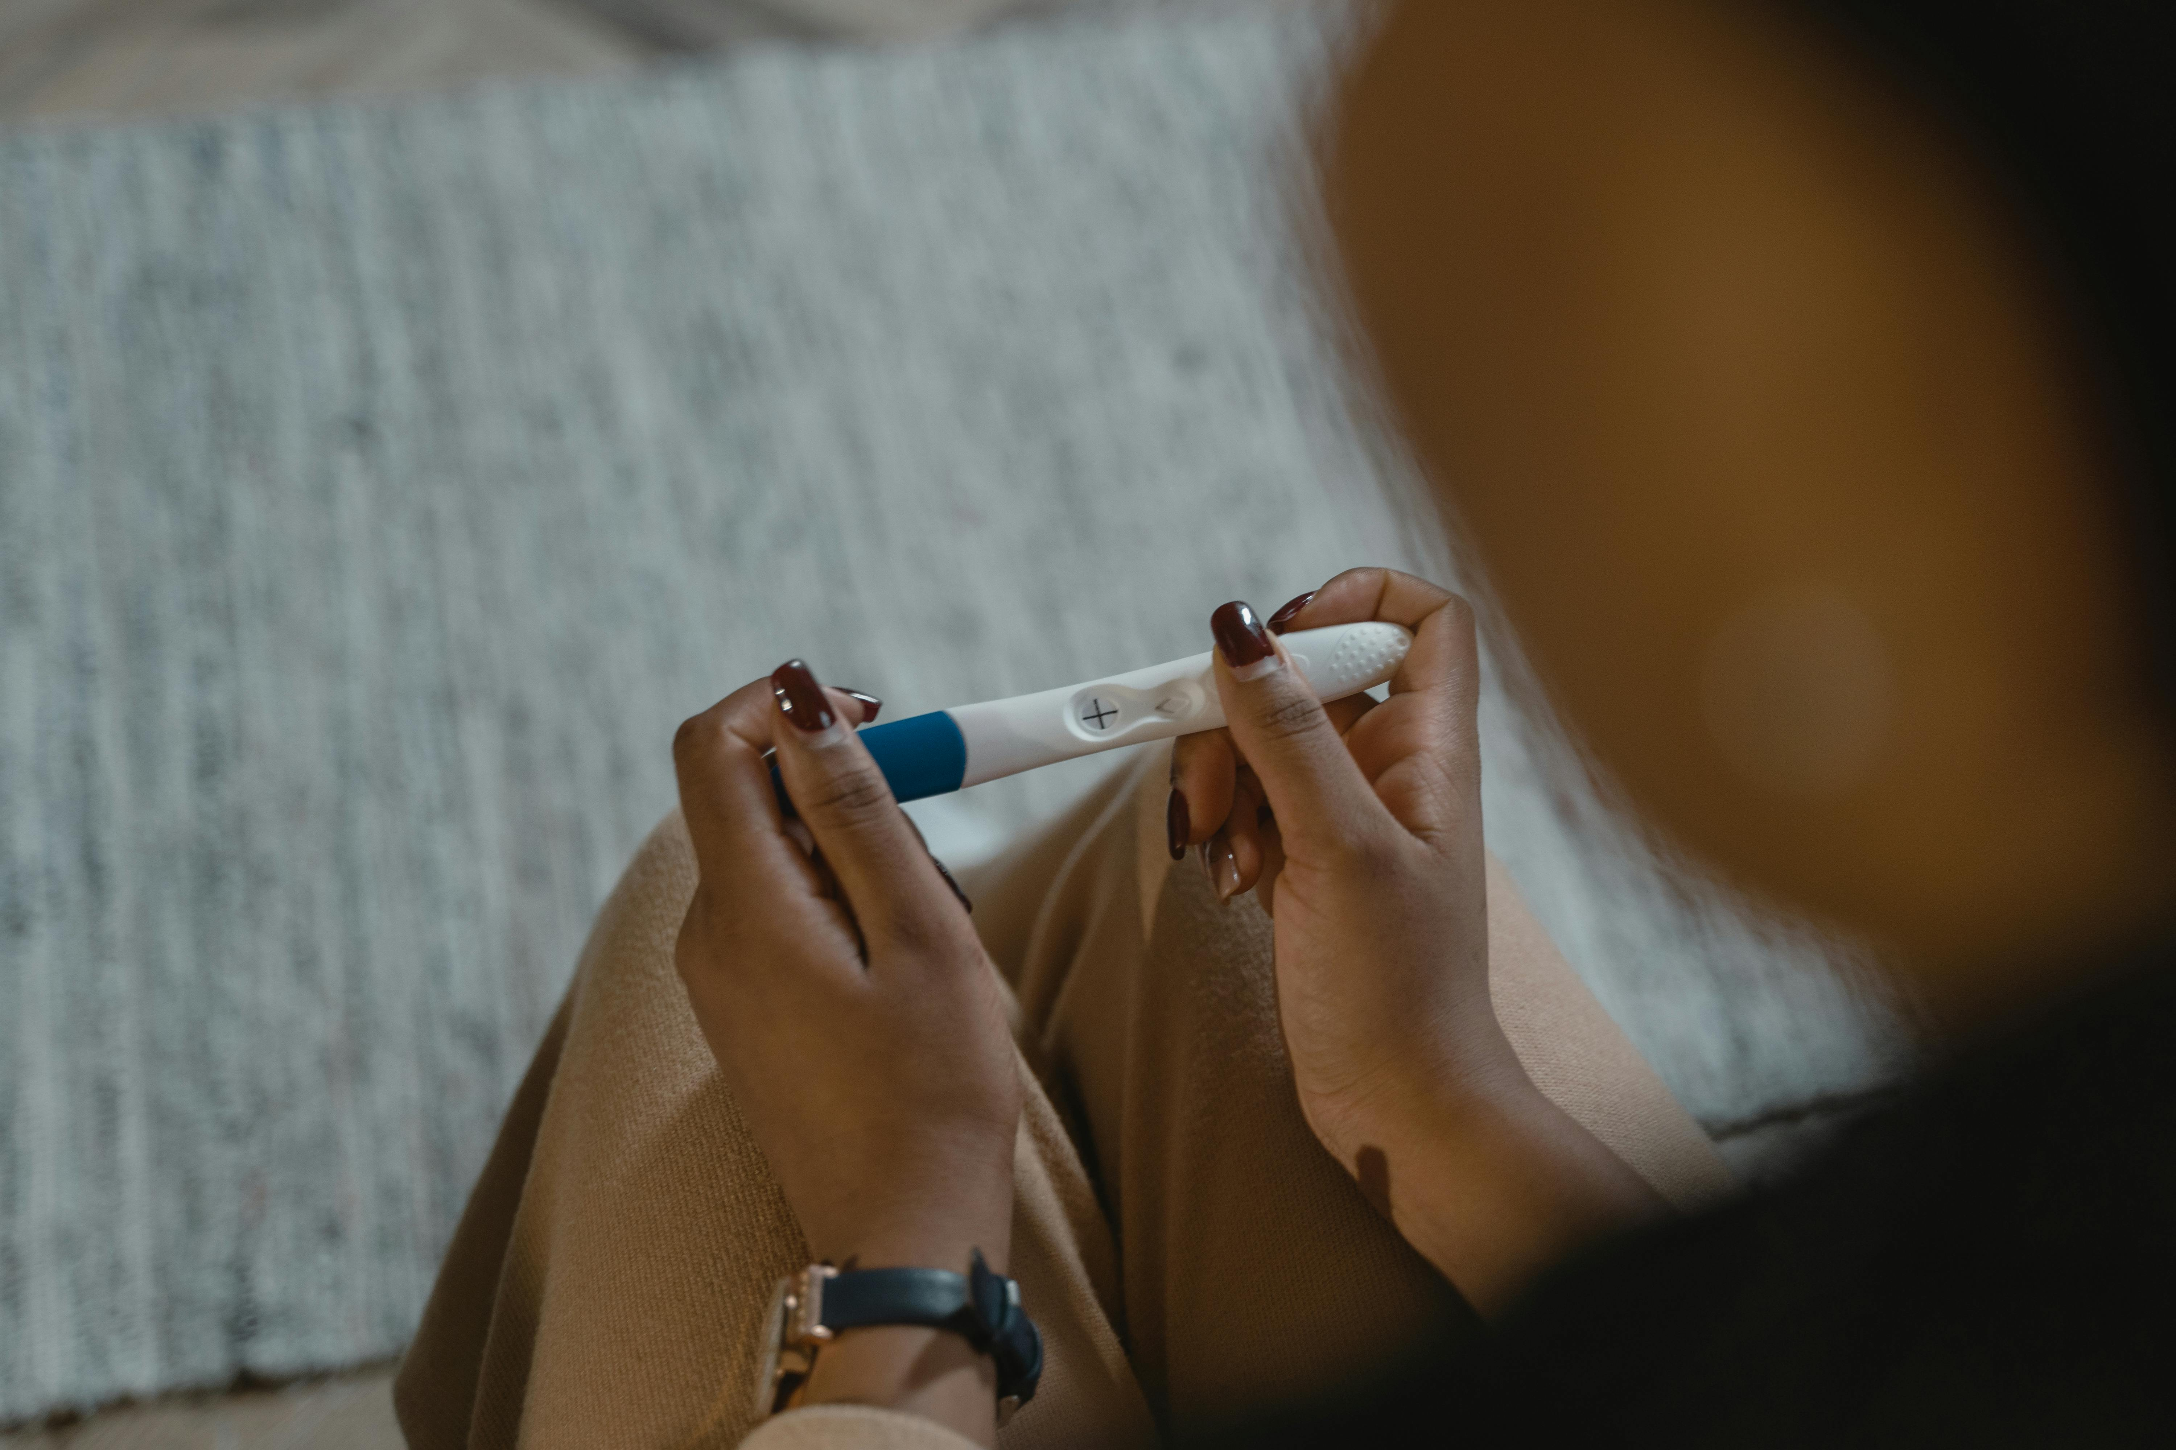
Let’s face down the darkness
Abortion is sinful
A Better Rescue remains: Son of God come near
Behold the blessings!
John 1:1-14
Notes:
So let’s face down the darkness firsthand.
Picture yourself on the other side of the bathroom door,
locked and lying on the floor.
Suppose you’re crumpled among a heap of cardboard cartons,
paper wrappers, fine print inserts, and pregnancy sticks with little plus signs.
Assaulted at the party and impregnated unwillingly,
now throat knotted, eyes hot, guts twisting, spine quivering, fingers clenching.
The anxiety of obligations overtakes the excitement of opportunities like a midwinter storm cloud.
Conflicts engulf welfare like a mineshaft plunged under nightfall.
Reputation at risk, freedom and future in danger, success and sanity at stake,
pulse pounds, doubts and debts and defiance mount.
Baby daddy bullies you, father bawls you out, mom turns her back on you,
even the clinic technician diagnoses deformity.
Abandoned, ashamed, afraid, and what now?
The shadow of death settled over the valley.
It swallowed up the surrounding summits as well,
the kind of darkness where they weep and gnash their teeth.
And it blackens every bit as grim as you assume,
black like Hagar the handmaid having Abraham’s illegitimate issue,
like Bathsheba bearing a baby not belonging to her husband.
It gets black like Lot’s daughters when they liquored up and lay with the old man,
like the anonymous adulteress laid bare before the stone throwers.
It goes black like Mary knowing not a man and subject to public disrepute. [click]
The darkness has a name and it is sin, iniquity, and evil.
It goes by privacy, choice, rights, or just abortion,
heavy as any one of us in our own chronic hostility and dishonesty.
But working darkness on the outside doesn’t remedy the darkness on the inside.
It doesn’t safeguard anyone.
Lament whatever you’ve done that led to it. [click]
Because a better rescue remains.
There is an answer for the darkness.
The deep shadow has not arrived alone.
Light always attends.
It’s fit for power made perfect in weakness,
fit for heavenly involvement.
Son of God came near, at hand and at work,
made like his brothers in every respect,
form of a servant, likeness of mortal, and obedient unto death.
With grace and forgiveness from the outside,
Jesus enters, driving away the dark by the everlasting light of Lord God Almighty.
The Christ has died blameless to absolve your guilt,
and He’s returned from the dead so that your conscience and spirit have release.
There’s nowhere that darkness doesn’t touch,
but there’s nowhere that good Lord doesn’t accompany.
For those that but perceive it, life shines in the darkness.
To live is Christ, and I will fear no evil for Thou art with me.
His own special light creates life into our race no matter what age,
that all may have life unconditional. [click]
Behold the blessings,
even on the other side of the bathroom door.
You’re awaiting ultrasound pulse and sonogram smile,
first word and first step, snuggles and giggles.
You’re anticipating birthday wishes and bedtime stories,
tea parties and fingerpaintings, pillow forts and water fights.
You’re at the threshold of wiping gameday sweat and drying homework tears,
learning to drive and late-night heart-to-hearts.
You’re appointed for graduation caps and wedding gowns,
“thank-you-mom”s and belonging.
Life shines in the darkness. [click]

Slide 4
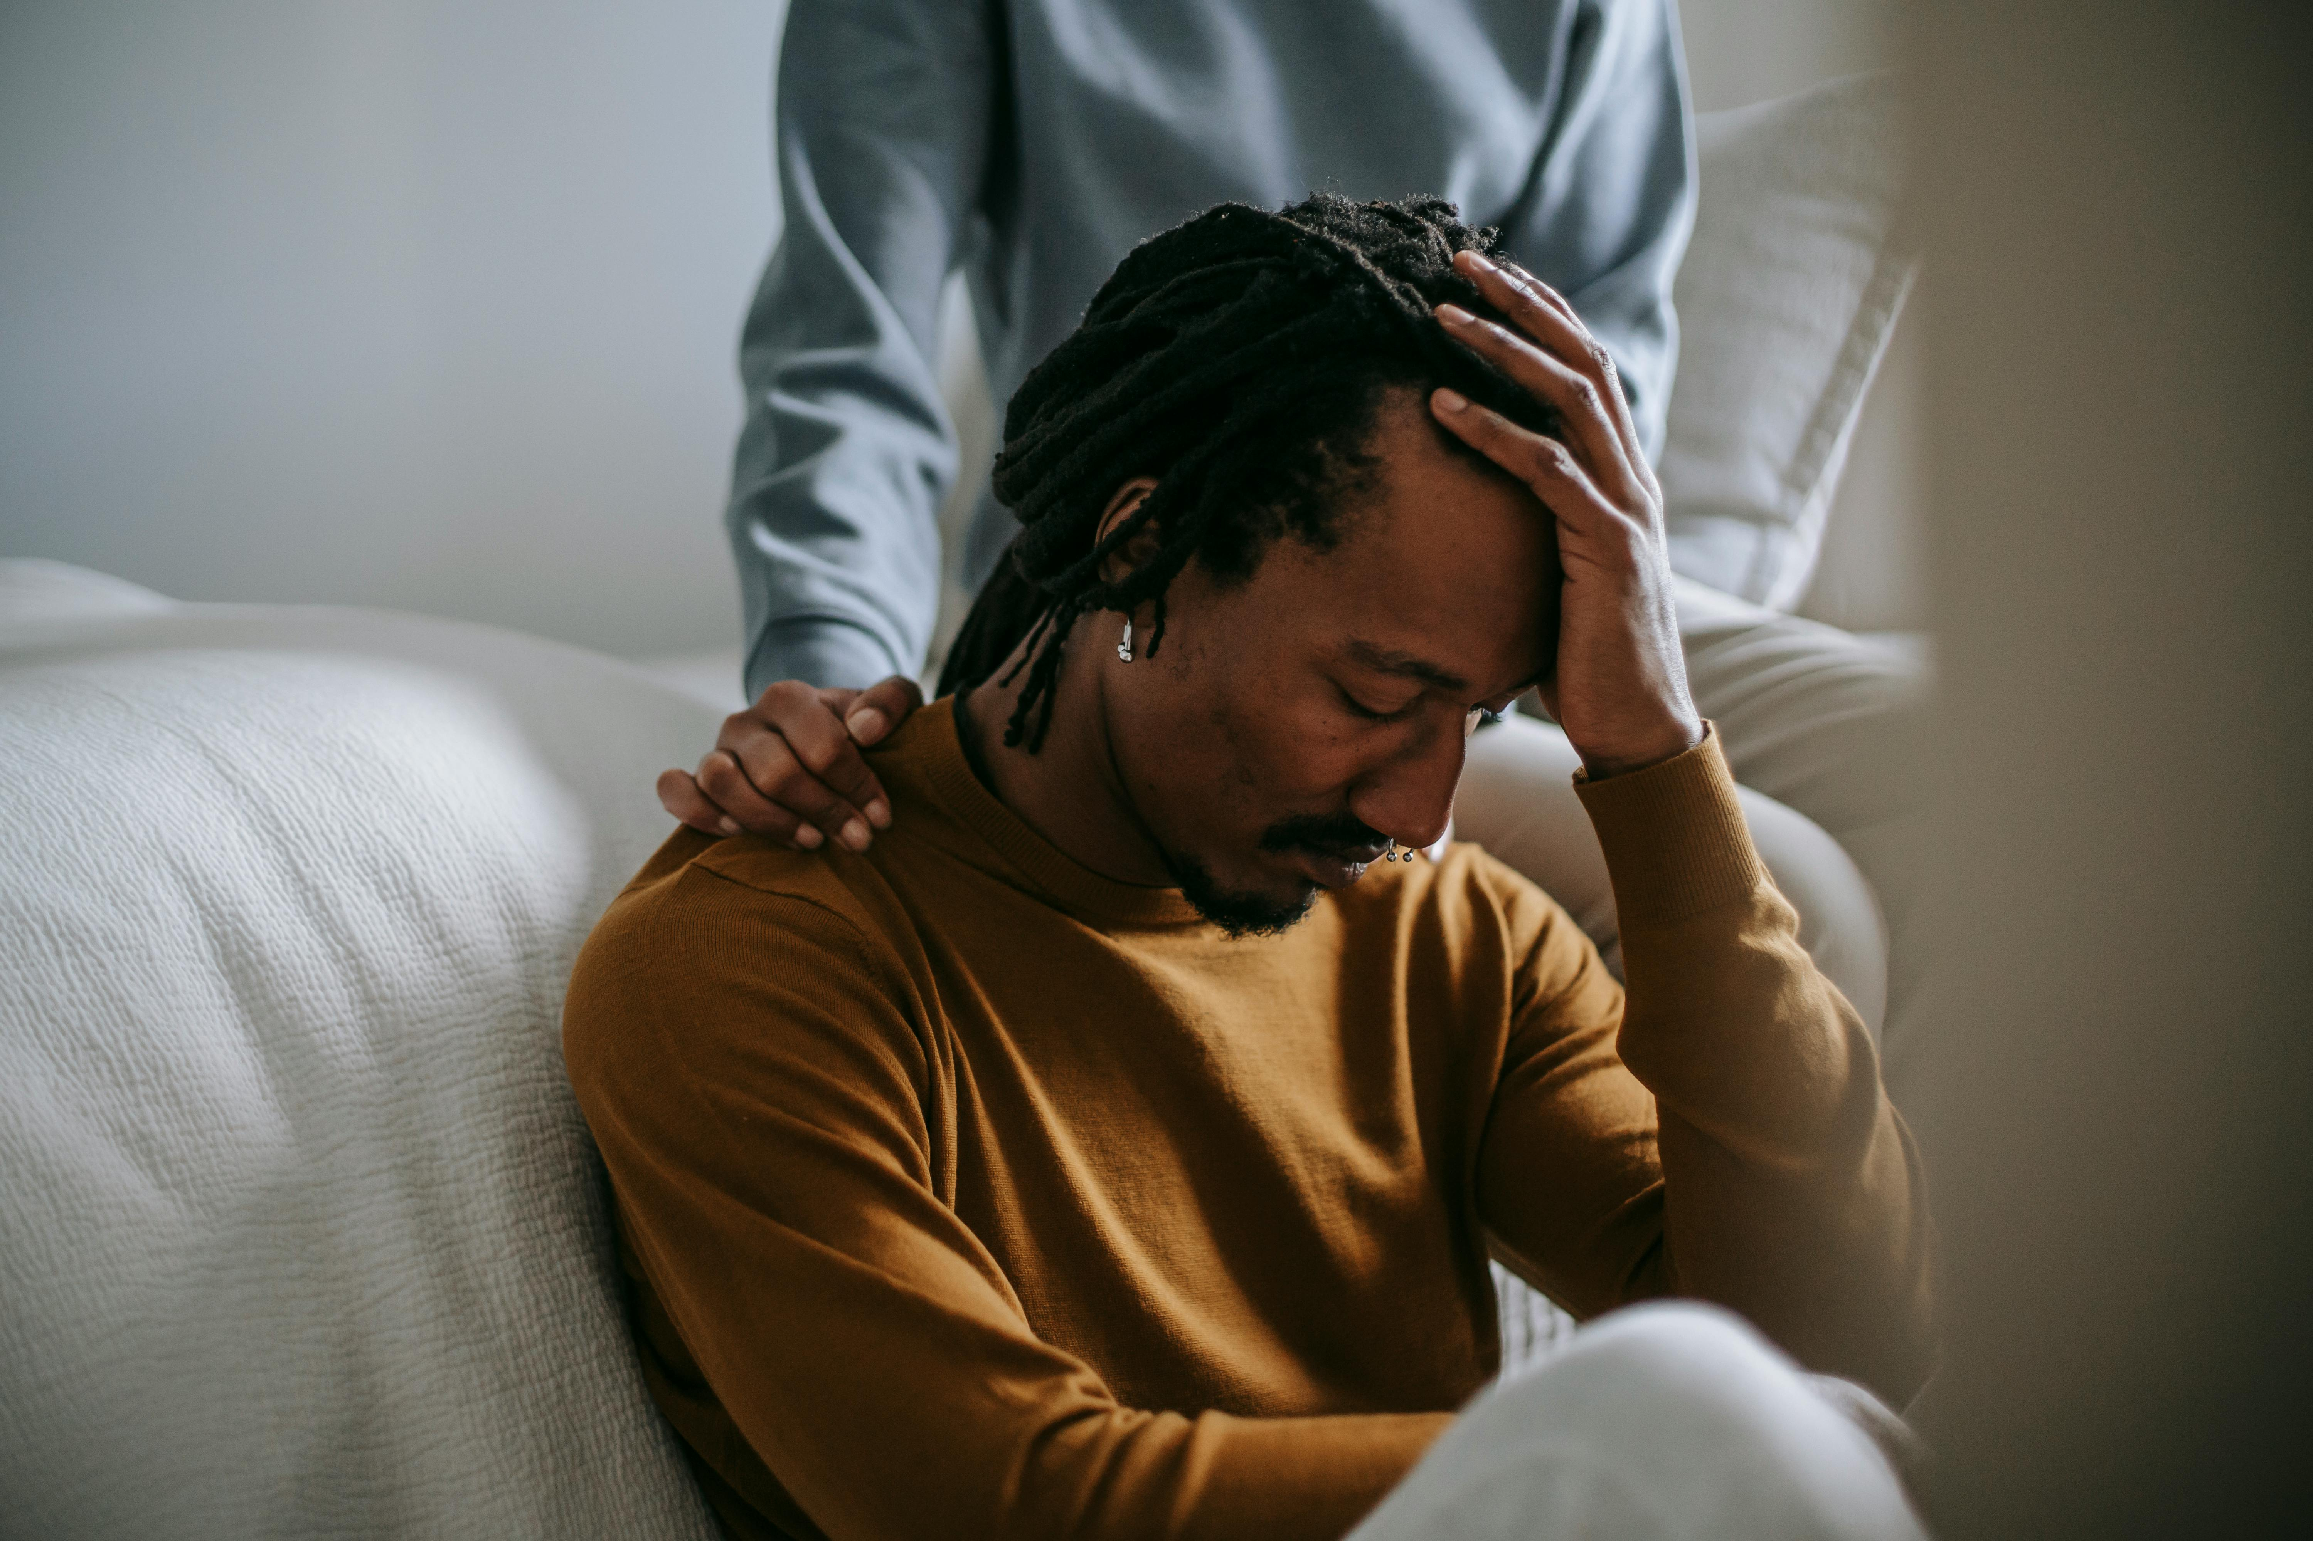
Let’s face down the darkness
Suicide is of the devil
A Greater Reversal remains: Eternal Word made flesh
Catch sight of the gifts!
John 1:1-14
Notes:
So let’s face it down head-on and not in fear.
Put yourself behind the bedroom door,
shoulders slumping and head hung low.
Say you’re buried under collection letters and divorce papers,
embarrassments replaying across your retinas and criticisms ringing in your ears.
Screams gone silent and tears run dry, the empty bottles mock you.
It’s brought you to your knees,
but you can’t put a clear word together or hold a distinct thought intact to pray.
Ready to make the haters pay, gaze at the blade like a misty graveyard.
Desperate to take the pain away, eyeball the bullet like a muggy backwoods.
Who would listen? Who would miss you?
Darkness settled over the whole land.
And you could feel it thick as pitch.
Behold, darkness covers the earth and thick darkness the peoples,
the sixth hour until the ninth hour, then stretching into three days.
And it burdens every bit as grave as you can imagine,
burdening like Elijah, exiled and exhausted while Jezebel hunted him,
imploring, “Take away my life!”
It leaves you burdened like Paul, afflicted in the flesh and imprisoned place after place,
appealing, “Take away the thorns!”
It feels burdensome like Jesus, starved by the desert and sweating blood beside the bushes,
pleading, “Take away this cup!” [click]
The darkness has a name and it is death, devil, and hell.
Some call it escape, ending it all, giving up, or just killing yourself,
empty as any one of us in our own customary uncharity and jealousy.
But wielding darkness on the outside won’t relieve the darkness on the inside.
It doesn’t secure anything.
Confess all you’ve loved that let it happen. [click]
Because a greater reversal remains.
We have an antidote to the darkness.
The thick abyss does not invade on its own.
Light ever ensues.
It fits for sufferings not worth comparing with glory to be revealed,
fits for divine intervention.
Eternal Word was made flesh, present and powerful,
subject to weakness, sharing in the flesh and blood the same as the children.
With compassion and mercy from above,
Jesus engages, casting out the darkness by heavenly light of life.
This Christ has died innocent as atonement for your sin,
and He’s risen again so that your body and being have relief.
There’s nobody the darkness doesn’t hunt,
but there’s nobody the good Lord doesn’t usher.
For all who but believe it, life shines in the darkness.
He is the Way, the Truth, and the Life,
And neither death nor life nor things present nor things to come will separate.
His own precious light redeems life into our kind regardless of appearance,
that we may have life abundant. [click]
Catch sight of the gifts,
even behind the bedroom door.
You’re encountering outlet for the tension and escape for the pressure,
another knowing what you’re going through.
You’re enlisting in shedding control and settling into trust,
standing alongside and sitting with.
You’re expecting sensitivity to colors, aromas, textures, and tones,
second chance and next chapter.
You’re entitled to grasping what matters most,
honesty and endurance, “I-need-you”s and relationship.
Life shines in the darkness. [click]

Slide 5
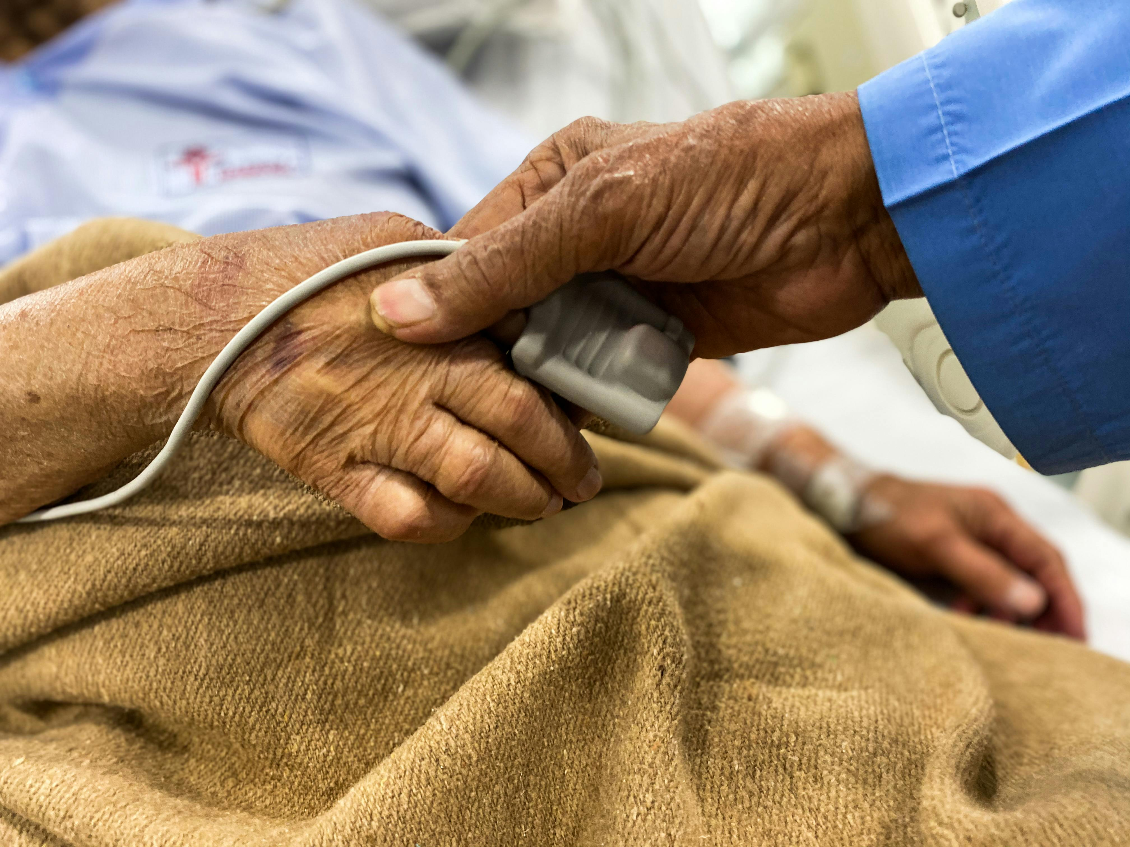
Let’s face down the darkness
Physician-assisted suicide is wickedness
A Truer Redemption remains: Lamb of God incarnate
Witness the privileges!
John 1:1-14
Notes:
So let’s face it down toe-to-toe and not flee.
Place yourself beyond the back room door,
drifting between consciousness and confusion,
mind too dim and mouth too dry to construct communication.
See you hooked up to ventilator and catheter,
hemmed in by bed rails and monitor beeps.
Layered under severe diagnoses and several drugs,
apologetic specialists quit counting and suspended the measurements.
Edema in extremities, abdominal nausea, and aching everywhere else, like an after-hours alleyway.
Spoon-fed and sponge-bathed, like a dilapidated shack.
Who’d live like this? Why not speed the process?
Sun turned black and moon to blood.
Cosmic powers spread this present darkness in the heavenly places.
And it befouls every bit as ghastly as you would envision,
blotched like past-his-prime Peter, dressed by someone else and led where he didn’t want.
It blemishes us like Job, bereft of everything dear and beset with terrible disease.
It blights all like Cain or Naaman or Bartimaeus,
even like Jesus Himself, disrobed and disfigured. [click]
The darkness, it has a name and it is wickedness, wrongdoing and lawbreaking and disobedience.
You know it as end-of-life options, medical aid in dying, or death with dignity,
menacing as every one of us in our own characteristic idolatry and blasphemy.
But wreaking darkness outside can’t heal the darkness inside.
It doesn’t sustain anyhow.
Repent anything you’ve become that left you here. [click]
Because a truer redemption remains.
Here comes an authority over the darkness.
The pitch black cannot occupy all by itself.
Light inevitably unseats it.
It fits us for flesh that manifests Lamb of God sacrificing and arising,
fits us for holy incarnation.
Almighty Immanuel gave self, mighty and moving.
Messiah Immanuel gave self, mighty and moving,
high priest carrying sicknesses and bearing sorrows,
able to sympathize and tempted as we but without surrender.
With substitution from on high,
Jesus embraces, pushing back the dark by divine light of love.
Your Christ has died righteous in exchange for your soul,
and He’s resurrected so that your very soon and evermore have rejoicing.
There’s nothing that darkness doesn’t crush,
but there’s nothing that the Lord God doesn’t clutch.
For if we but receive it, life shines in the darkness.
He is the resurrection and the life never-ending,
who keeps whole spirit, soul, and body blameless at the coming of His kingdom.
His own priceless light calls life into every human being through whatever ability,
that they may have life everlasting. [click]
Witness the privileges,
even beyond the back room door.
You’re discovering concerns cast aside and distractions dismissed,
Singing to and praying with.
You’re ordained into validating vulnerability
and honoring them with your needs.
You’re due for expressing the “haven’t-said-yet”s and testifying the “meant-to-tell-ya”s.
You’re advancing toward family reunited and history relived,
gripping hands and kissing foreheads, “I-love-you”s and community.
Life shines in the darkness. [click]

Slide 6
John 1:1-14
Expose the unfruitful darkness
Proclaim the excellencies of Light!
Notes:
Take no part in the unfruitful works of darkness.
Instead, expose them.
We are a chosen race, a royal priesthood, a holy nation, a people of God’s own possessing.
And you may proclaim the excellencies of Him who called you
out of darkness into His marvelous light.
They will see His face, and His name will be on their foreheads.
Night will be no more, and they will need no light of lamp or sun,
for the Lord God will be their light,
and they will reign forever and ever. Amen.

